Slide 1
Oxford 2027
Trinity College

Slide 2
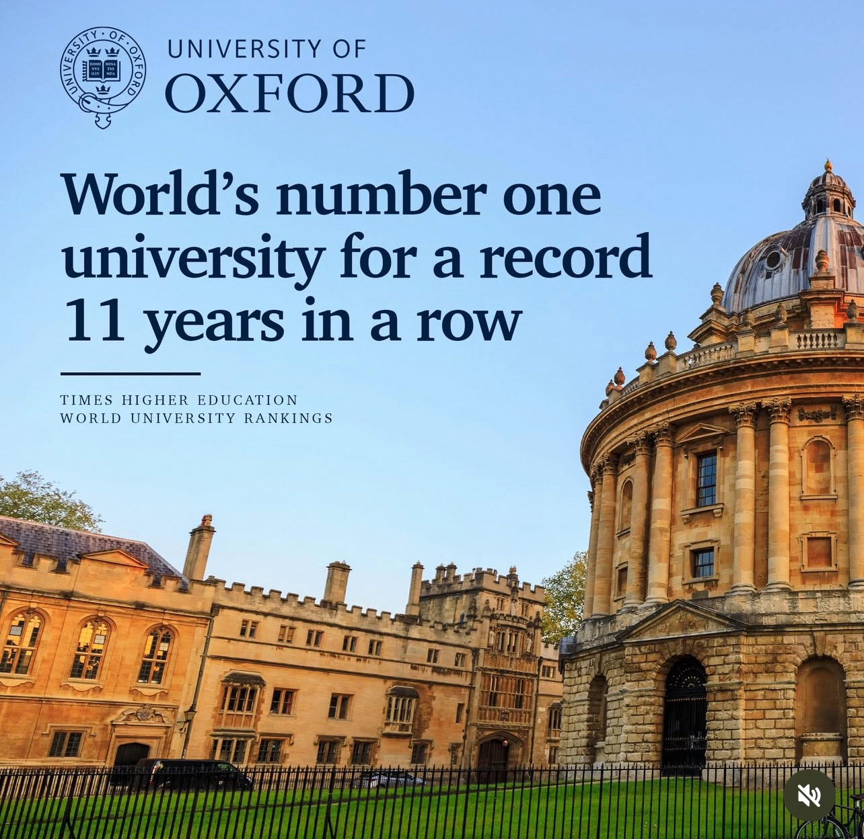
sbu.edu/oxford
Six-week summer program.
Live and study at perhaps the most famous university in the world.
Take classes with international scholars and experience real student life in England and Europe.
A life-changing experience.

Slide 3

Trinity College at Oxford University

Slide 4
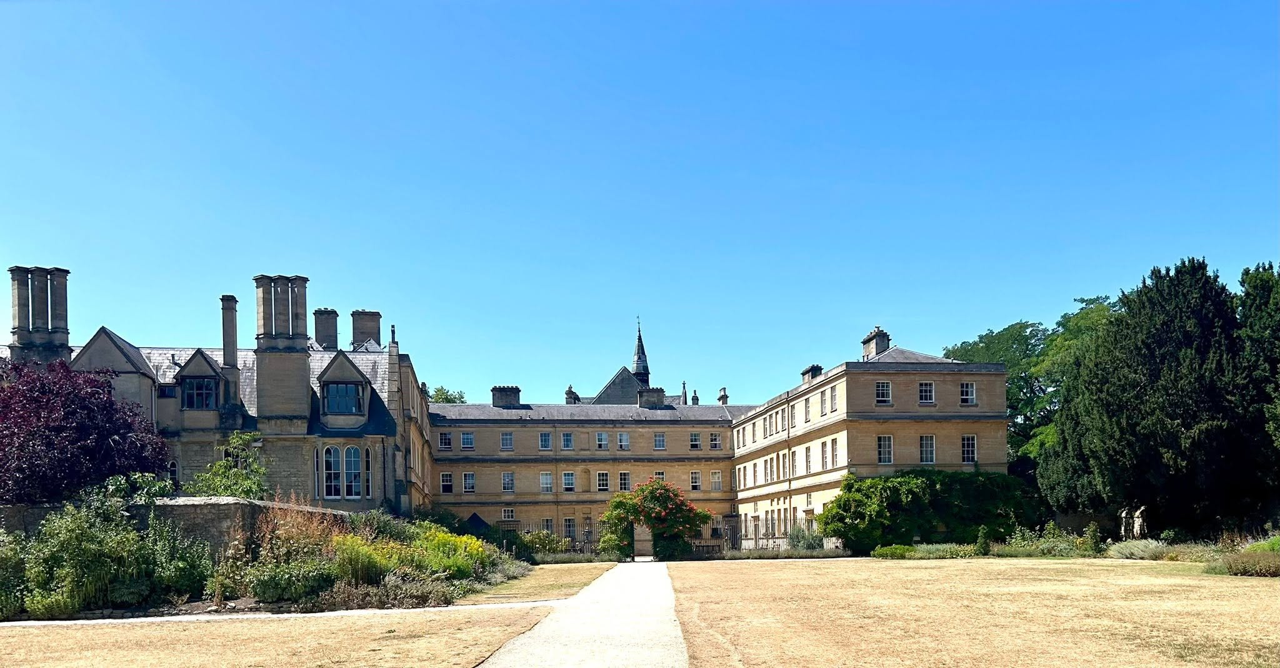
Trinity College at Oxford University

Slide 5
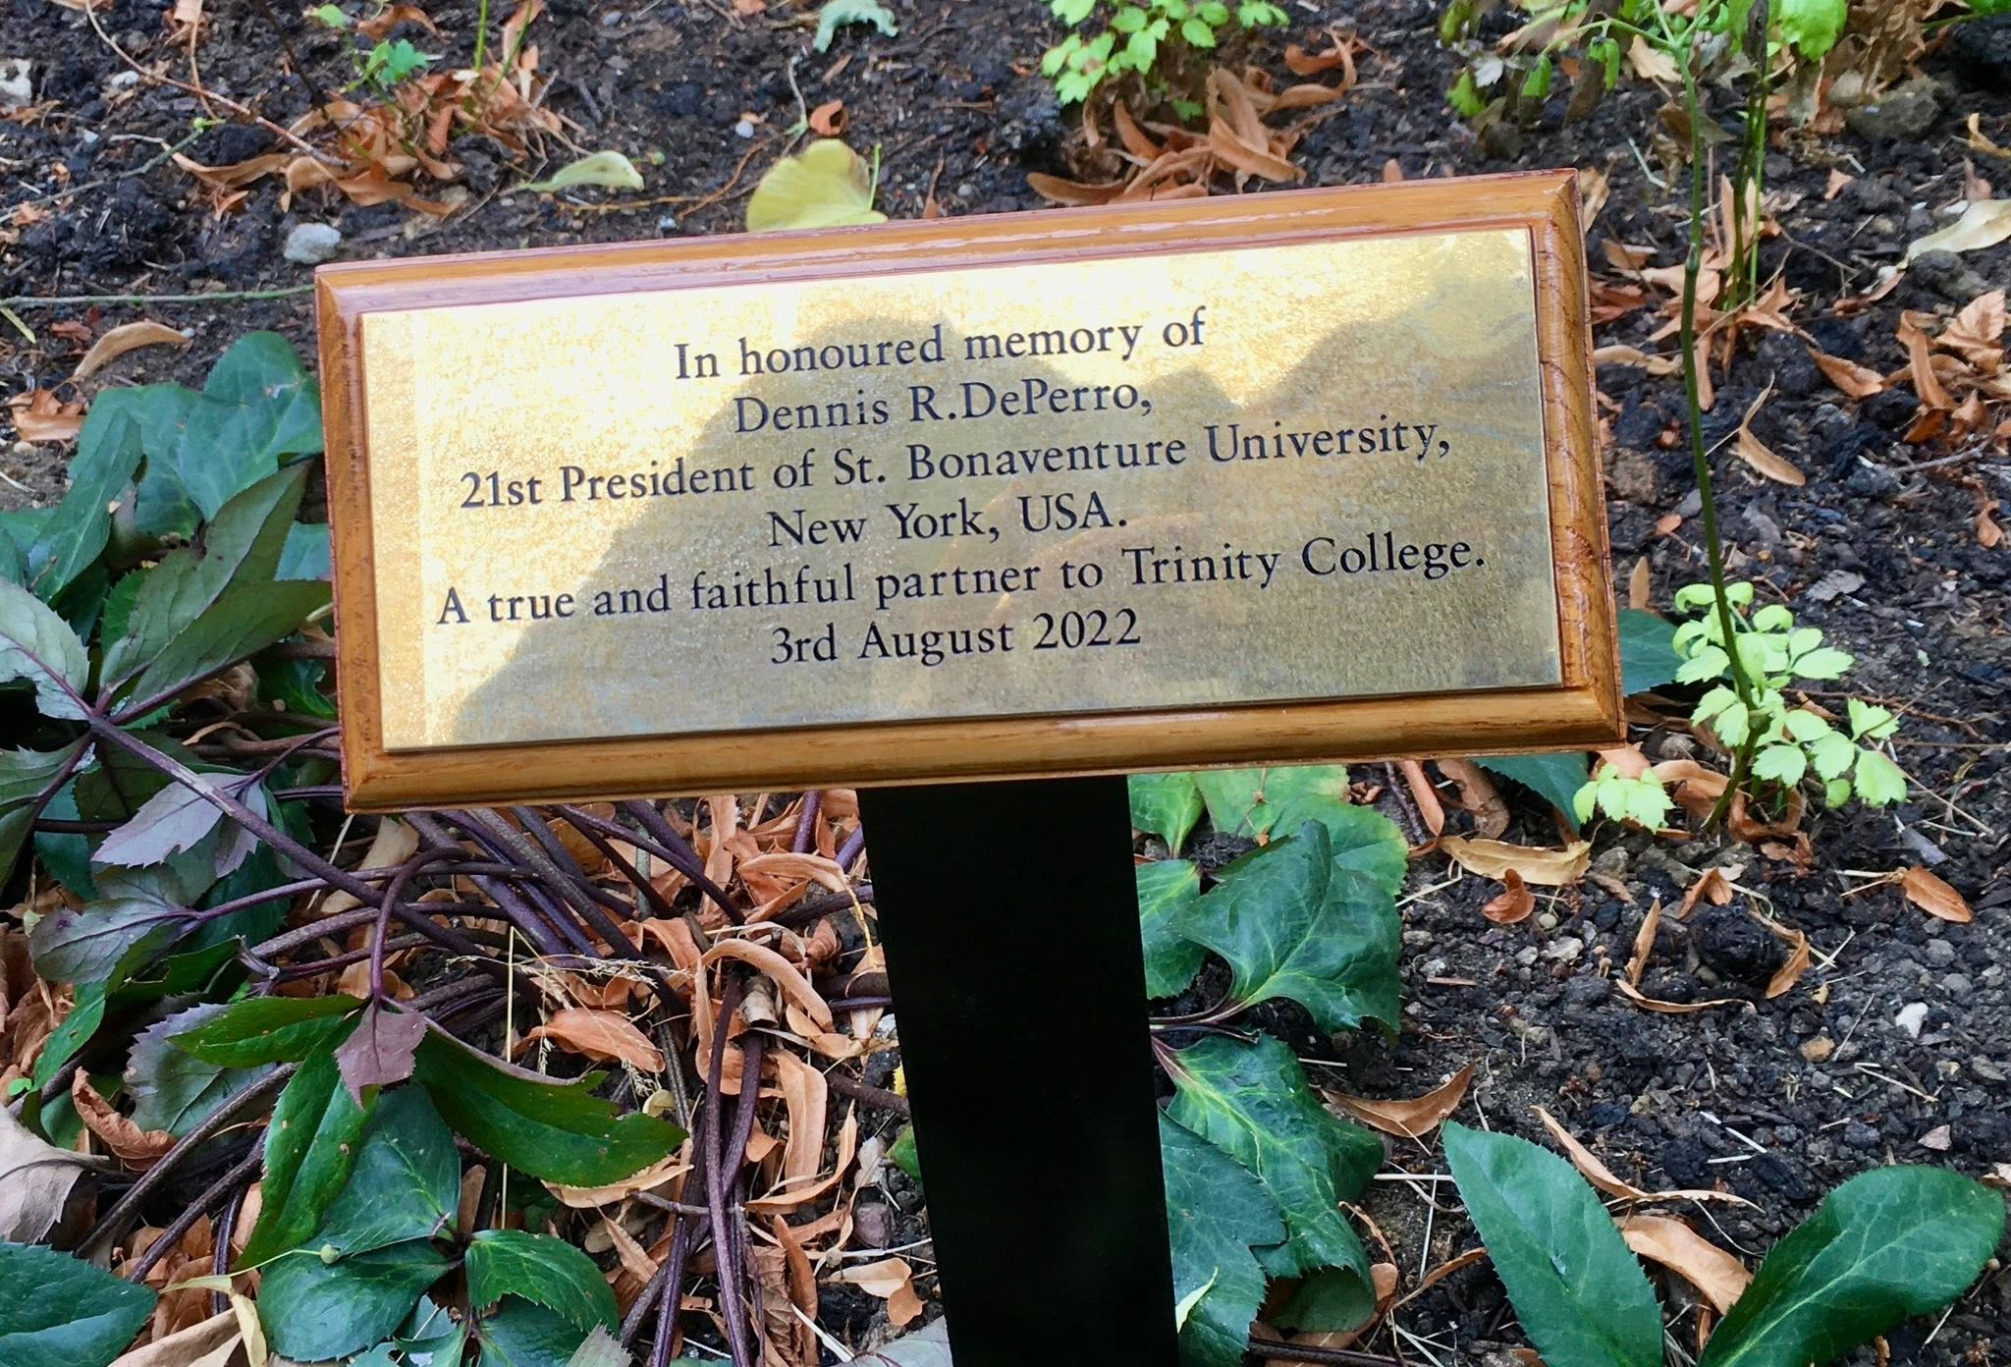
Trinity College at Oxford University

Slide 6
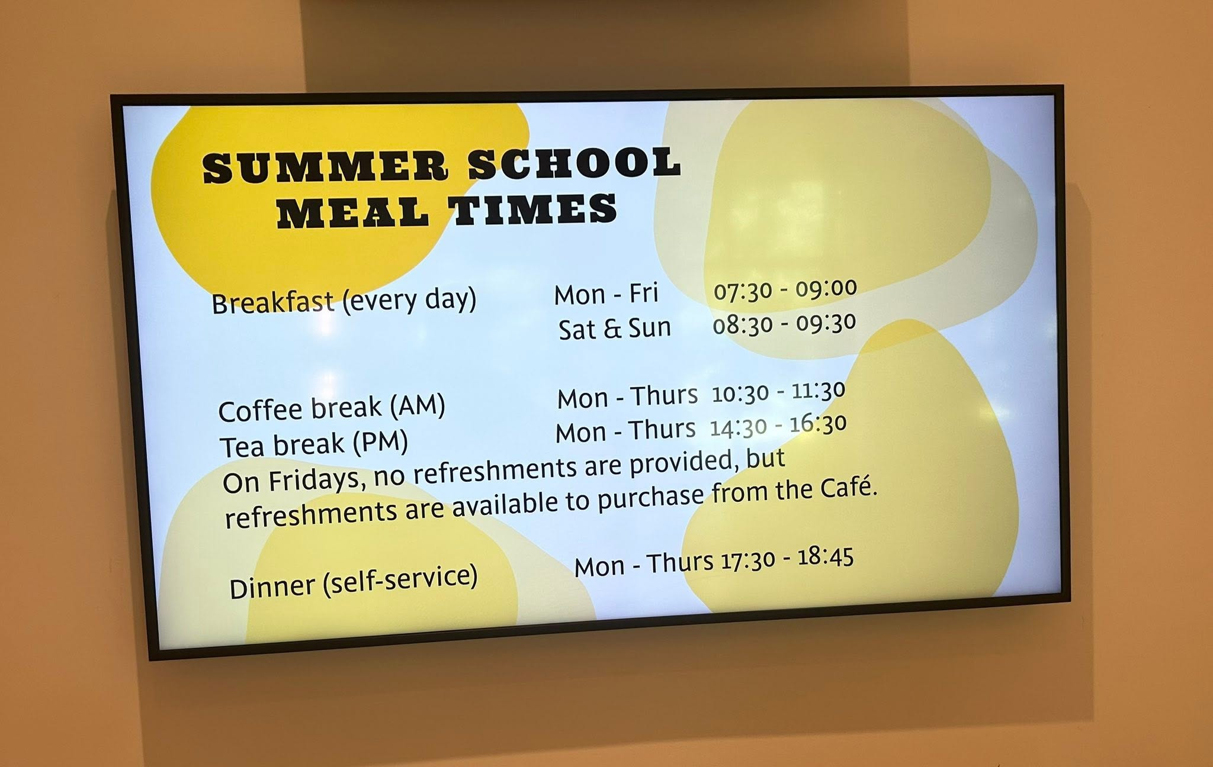
Trinity College at Oxford University

Slide 7
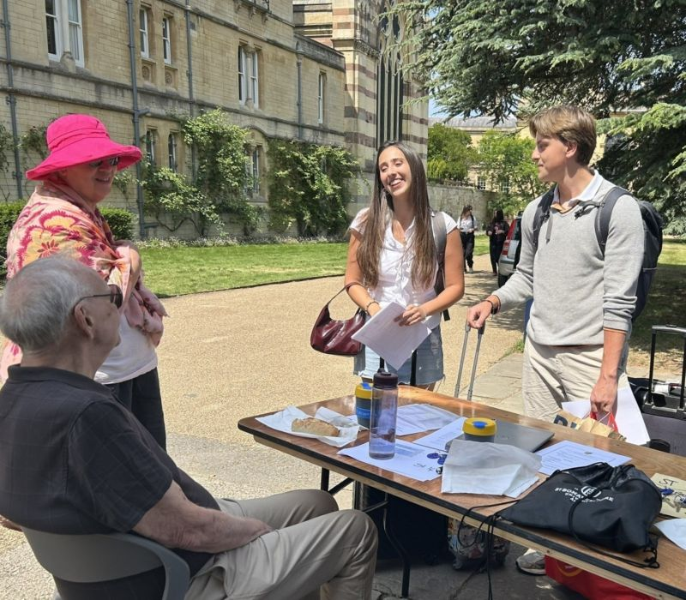
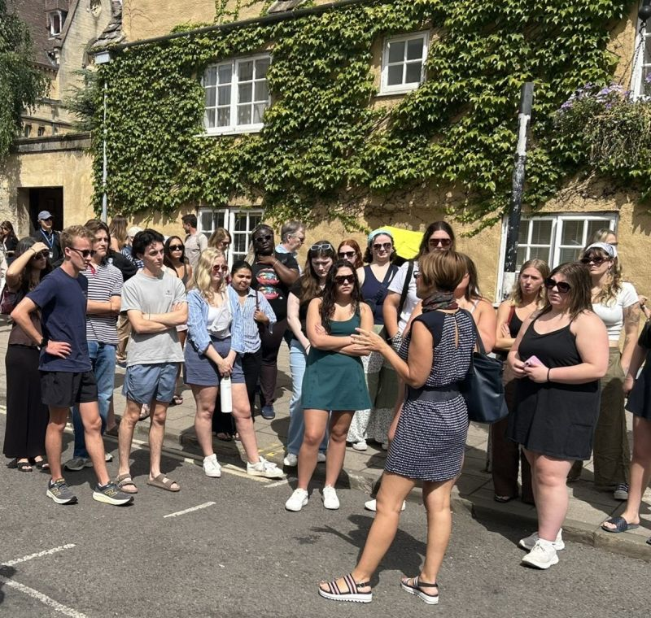
sbu.edu/oxford

Slide 8


sbu.edu/oxford

Slide 9
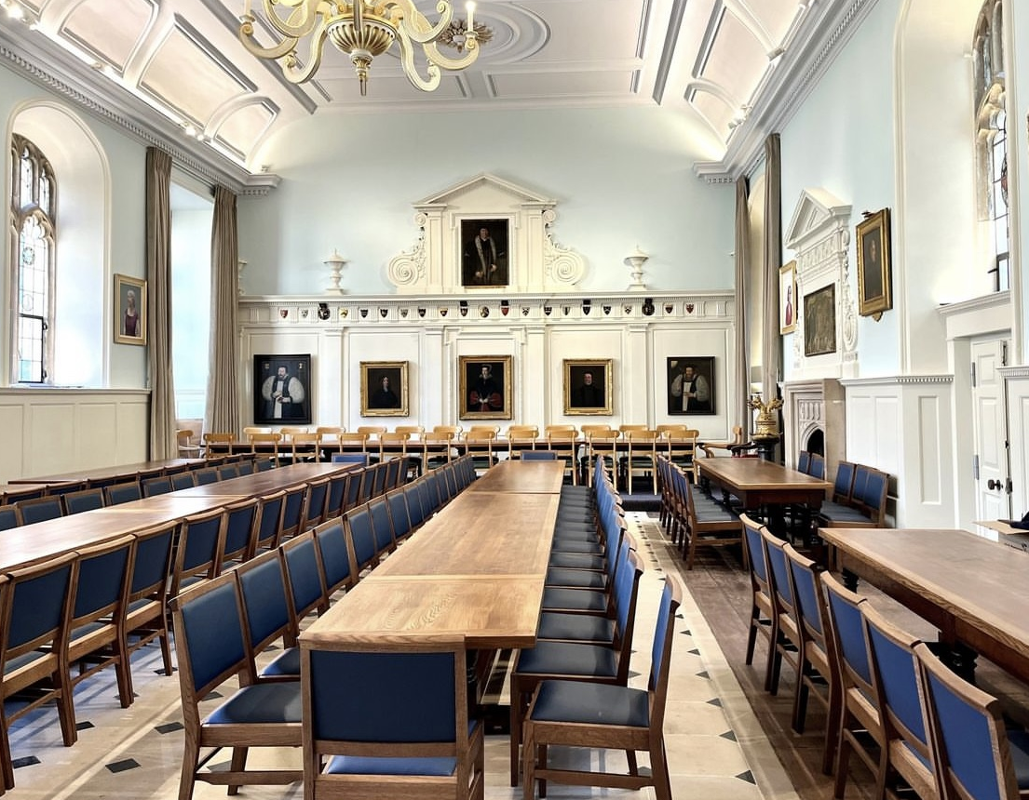
Trinity College at Oxford University

Slide 10
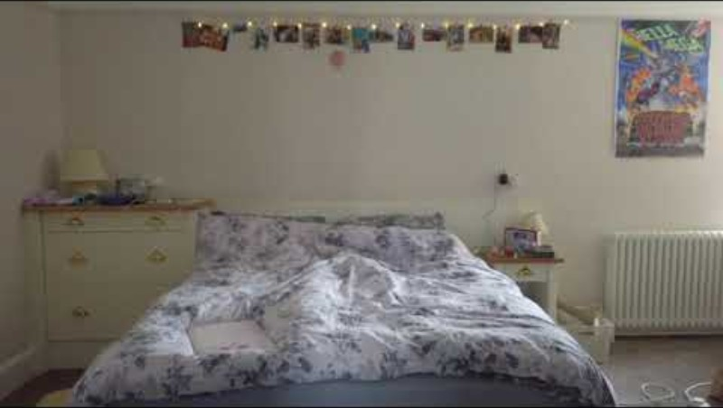
Trinity College at Oxford University

Slide 11
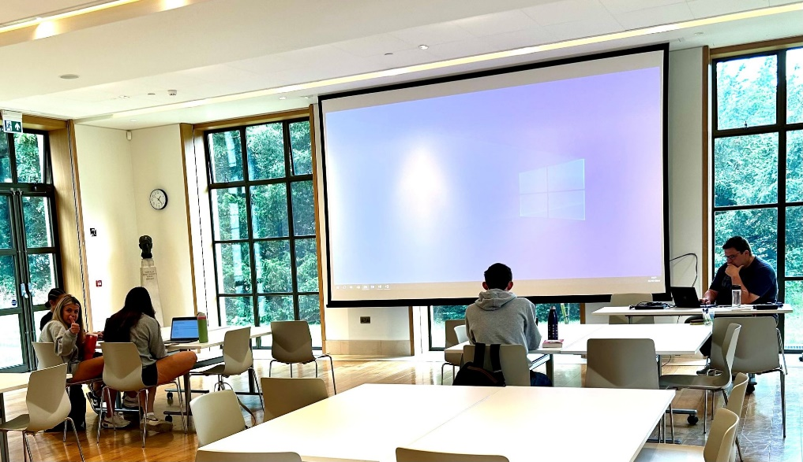
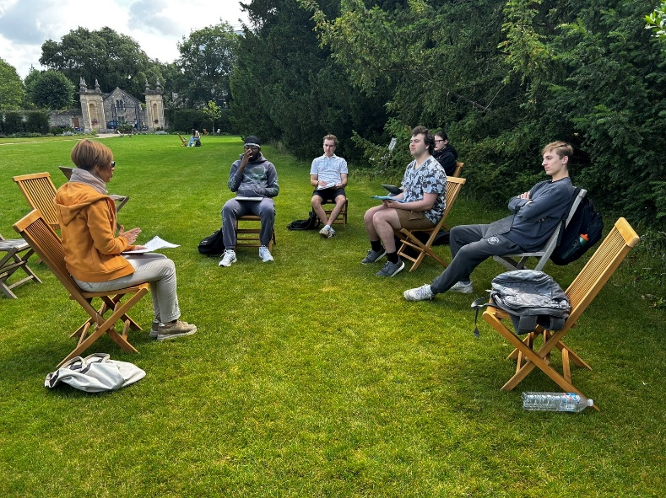
sbu.edu/oxford

Slide 12
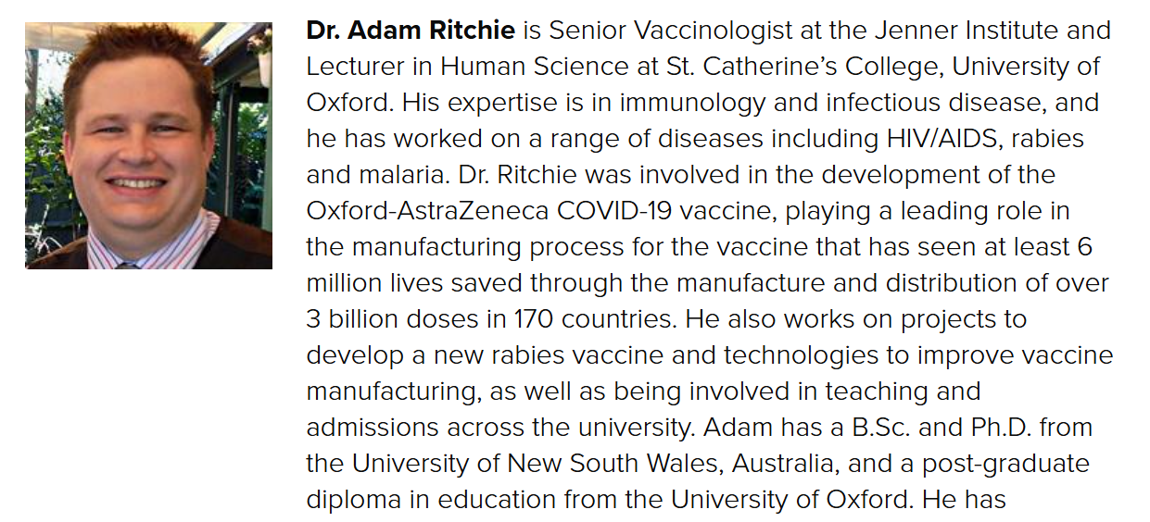
sbu.edu/oxford
Dr. Ritchie was involved in the development of the Oxford-AstraZeneca COVID-19 vaccine, playing a leading role in the manufacturing process for the vaccine that has seen at least 6 million lives saved through the manufacture and distribution of over 3 billion doses in 170 countries.

Slide 13
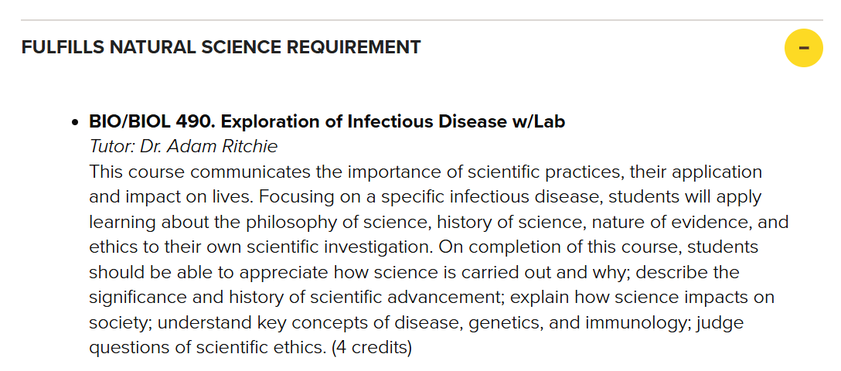
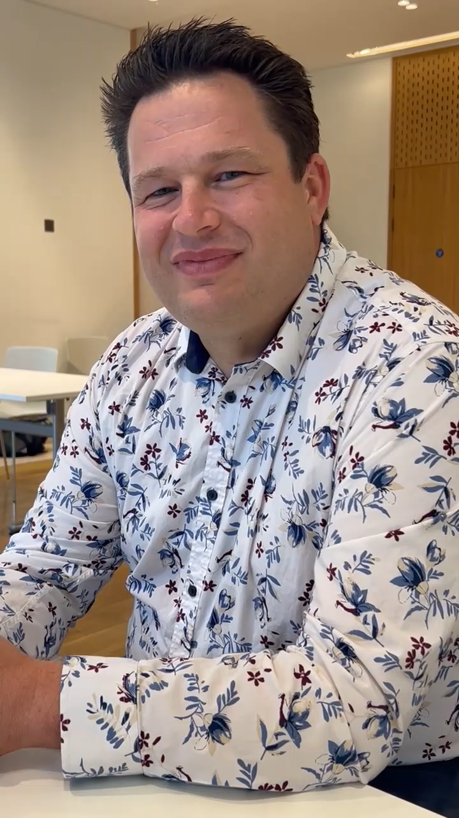
sbu.edu/oxford

Slide 14

sbu.edu/oxford

Slide 15
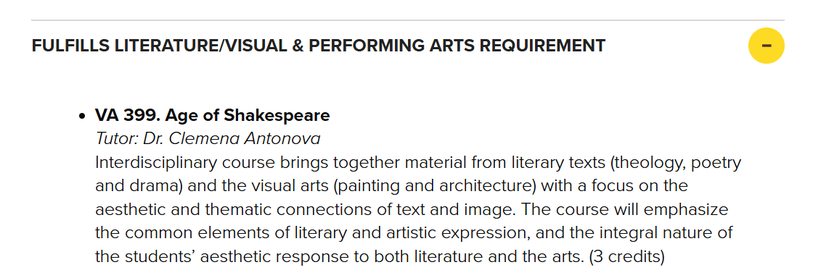
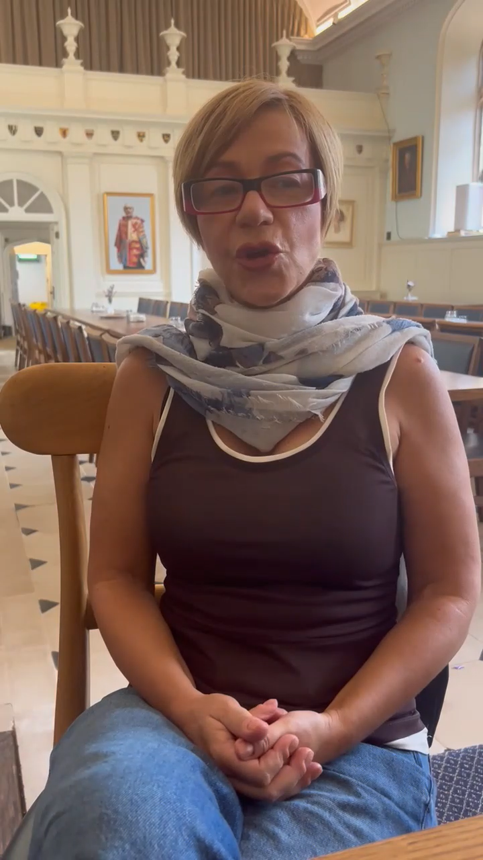
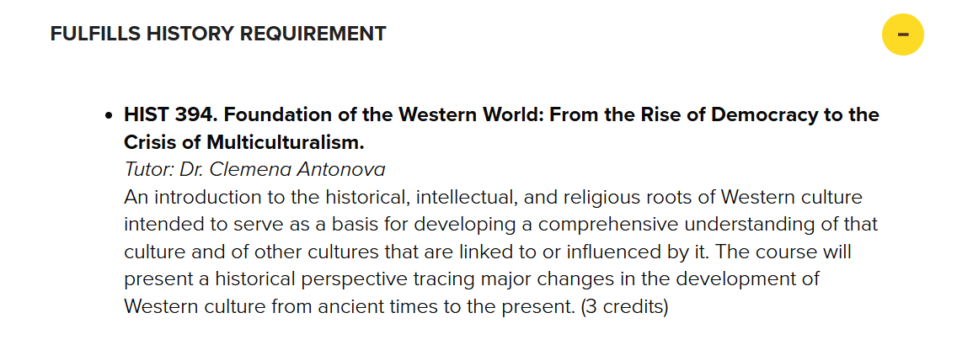
sbu.edu/oxford

Slide 16
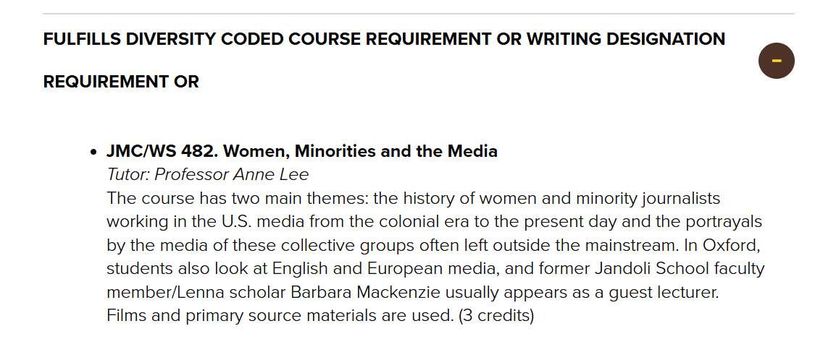
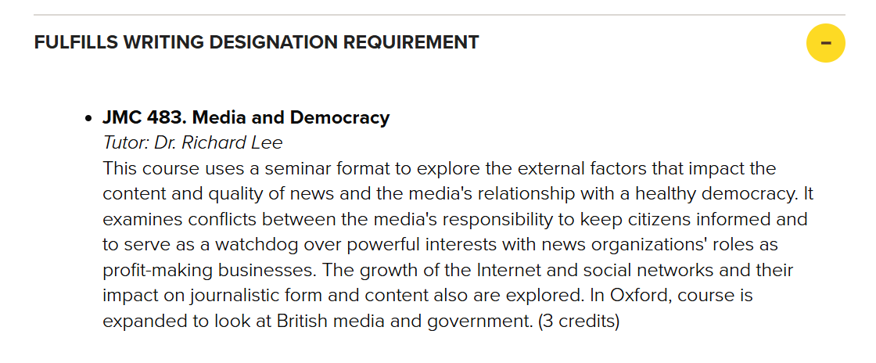
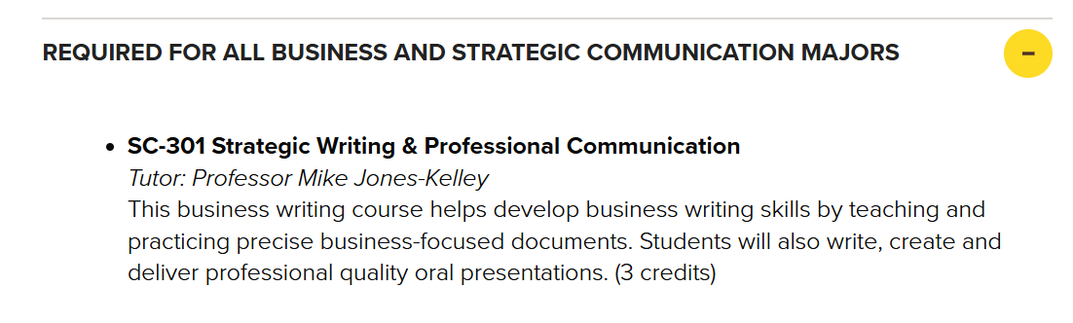
sbu.edu/oxford

Slide 17
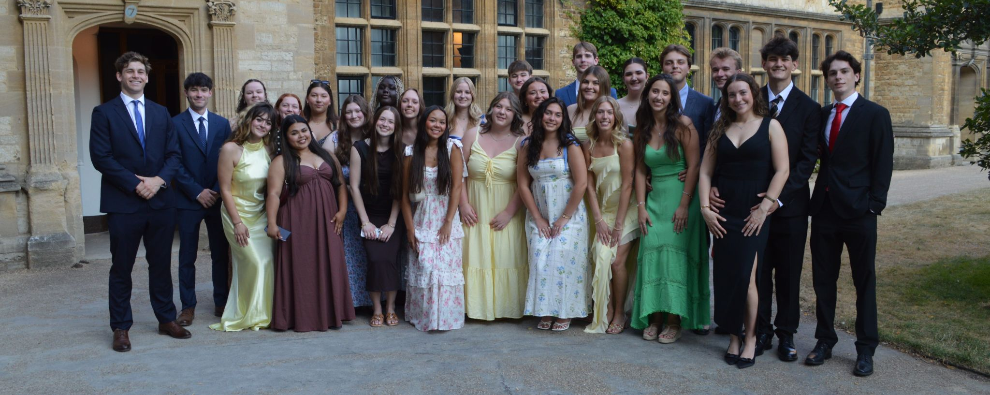
sbu.edu/oxford

Slide 18
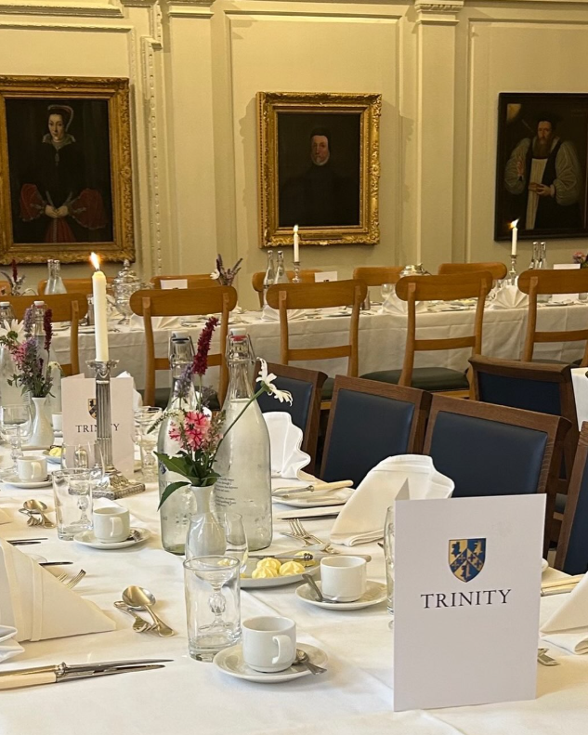
Trinity College at Oxford University

Slide 19
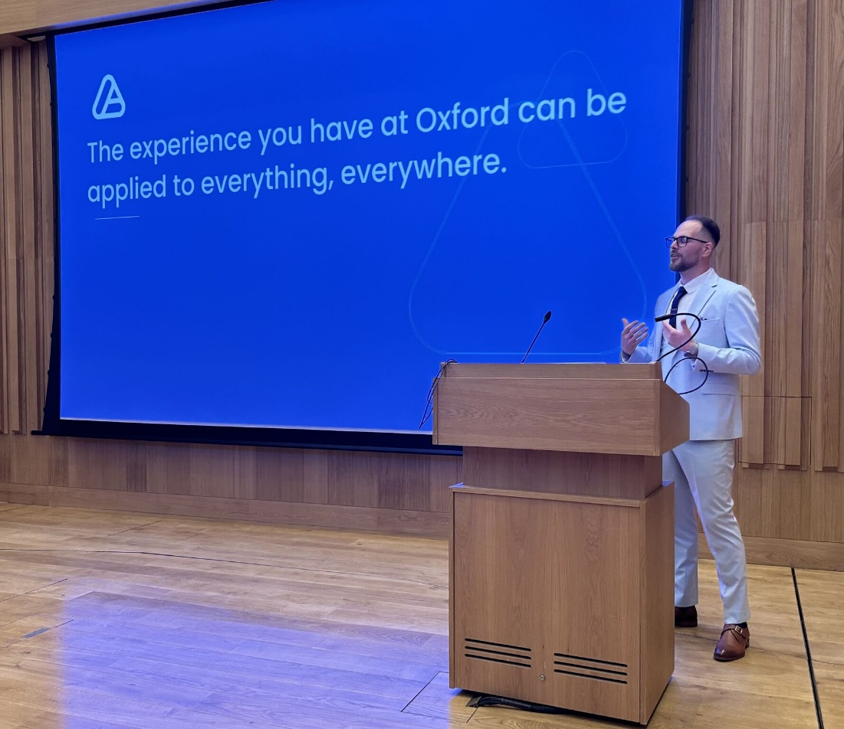
sbu.edu/oxford

Slide 20

sbu.edu/oxford

Slide 21
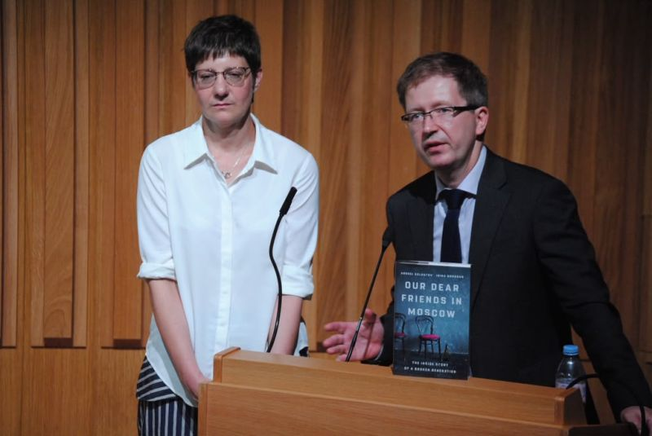
sbu.edu/oxford

Slide 22
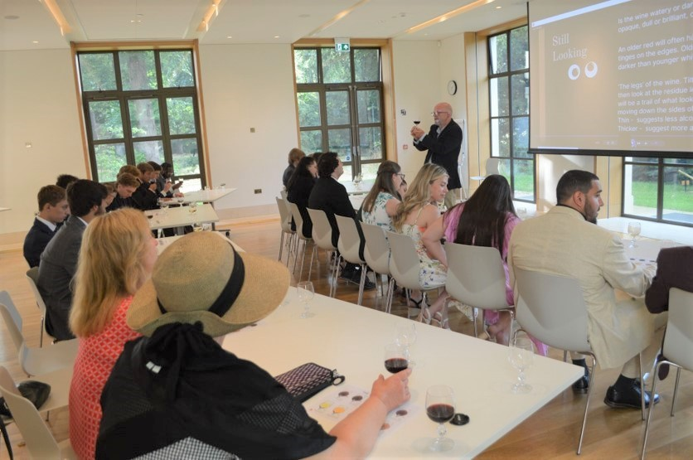

Trinity College at Oxford University

Slide 23

sbu.edu/oxford

Slide 24
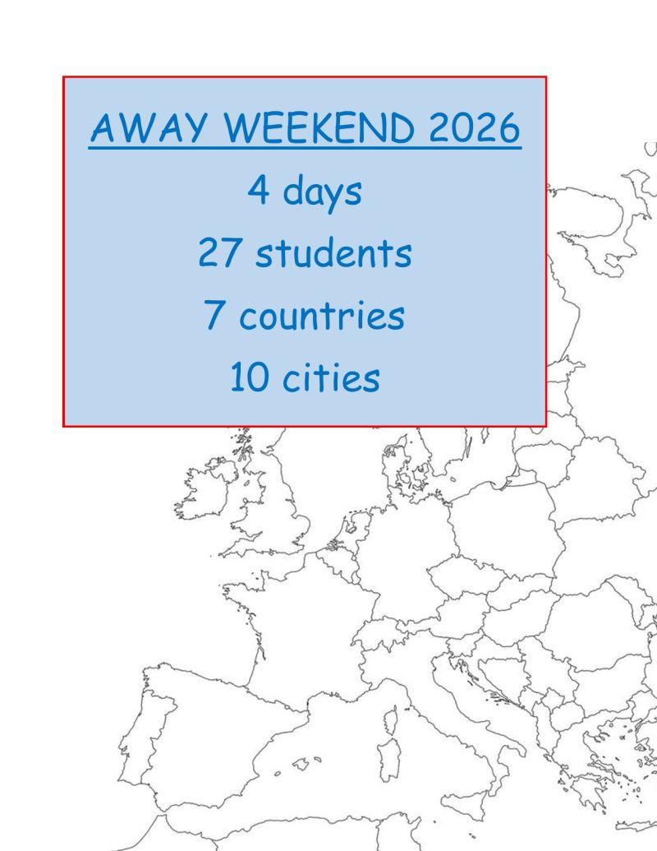
sbu.edu/oxford

Slide 25

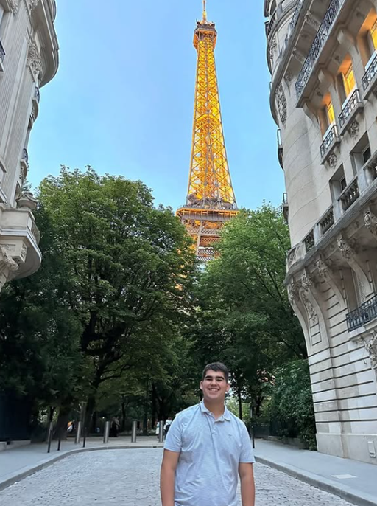
sbu.edu/oxford

Slide 26
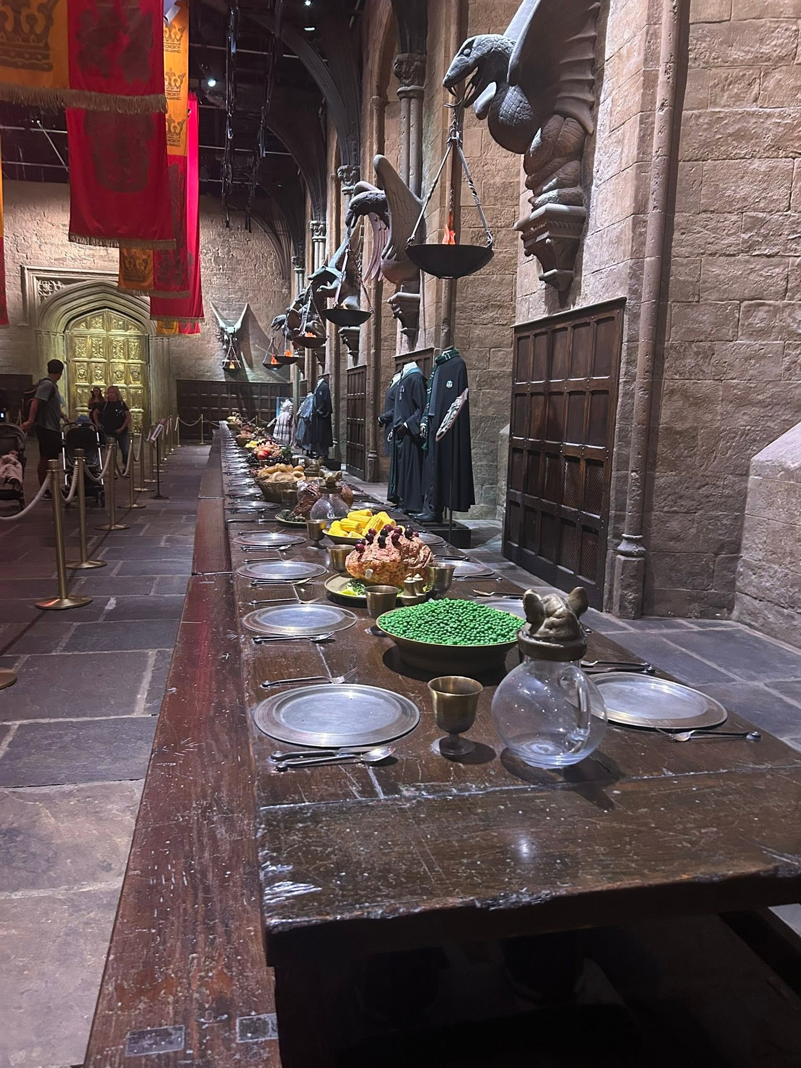
Trinity College at Oxford University

Slide 27

Francis E. Kelley Oxford Program
Mike Jones-Kelley, Program Director: mjoneske@sbu.edu
Anne W. Lee, Associate Director: alee@sbu.edu
Richard A. Lee, Assistant Director: rlee@sbu.edu
sbu.edu/oxford

