Slide 1
Fifty Years Later,
Are the Songs Still in the Key of Life?

Slide 2
Mid-Atlantic Popular & American Culture Association Virtual Symposium
July 26, 2026
---------
Anne and Richard Lee
St. Bonaventure University

Slide 3

Songs in the
Key of Life
Stevie Wonder’s 18th studio album was released Sept. 28, 1976.
It has been the best-selling and most critically acclaimed album of Wonder's career.
It is regarded as one of the greatest albums in the history of popular music.
It has 21 songs that are personal and universal.
It was Number One on the Billboard 200 for 13 consecutive weeks.
It won Album of the Year at the 19th Grammy Awards.

Slide 4
Initial Research Questions
Fifty years after its release, is Songs in the Key of Life still relevant?
Does it still connect on a personal level?
On a universal level?

Slide 5
METHODOLGY
Eight undergraduate college students watched two recent documentaries: one on Wonder’s life and one on the making of Songs in the Key of Life.
We assigned songs to students and initially asked that without research, they listen to their assigned songs “unfiltered” and provide written first impressions.
Later, after researching their assigned songs, students provided written feedback about what they learned.

Slide 6
METHODOLGY continued
Students provided written feedback about how their research amplified their initial impressions.
In a workshop session, the students identified themes and patterns that emerged as they listened to the songs and learned more about them.
Students also provided examples to support and illustrate the themes and patterns they identified.
They participated in general discussions of the research questions.

Slide 7
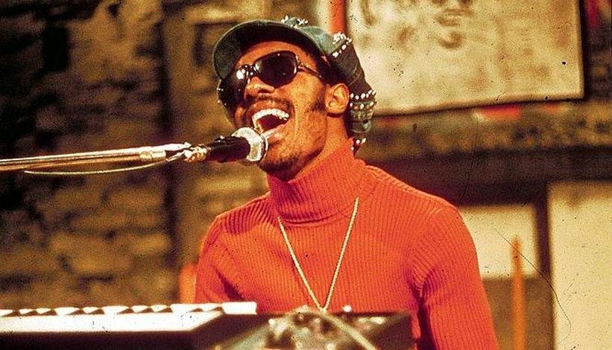
Themes Identified through Unfiltered Listening
Students recognized love as a theme in many of the songs.
They also noted the tone throughout tends to be upbeat and positive, split evenly between serious messages and positive and uplifting lyrics.

Slide 8
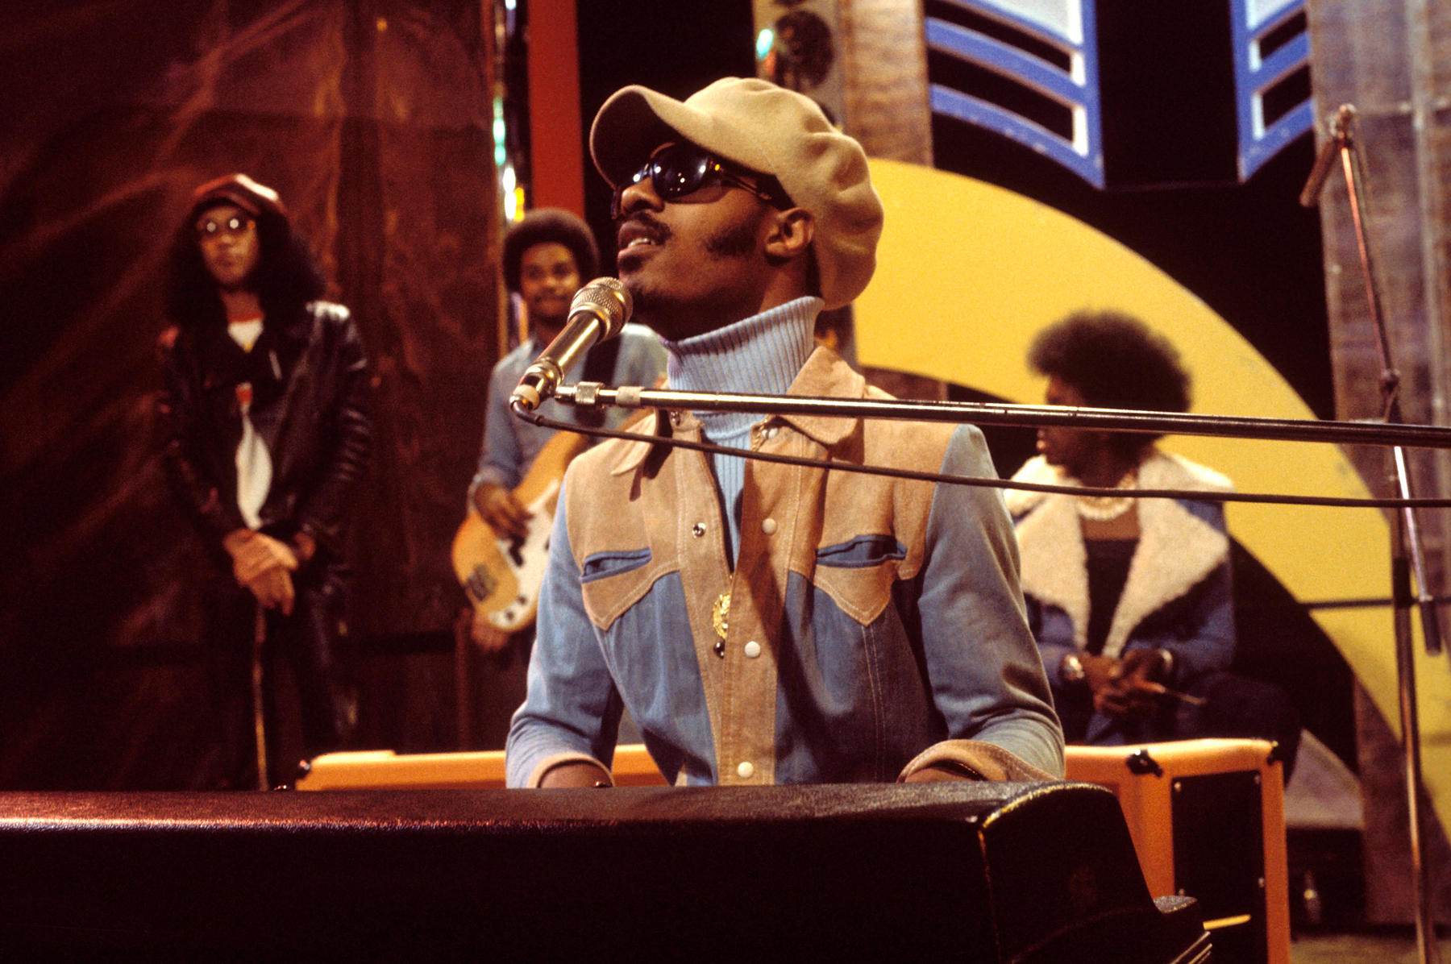
Unfiltered Listening continued
Students perceived the relevance of topics such as poverty and race, which remain very important in society.
The songs reminded students of music that is popular today.
And they strongly appreciated the background music as well as vocals.

Slide 9
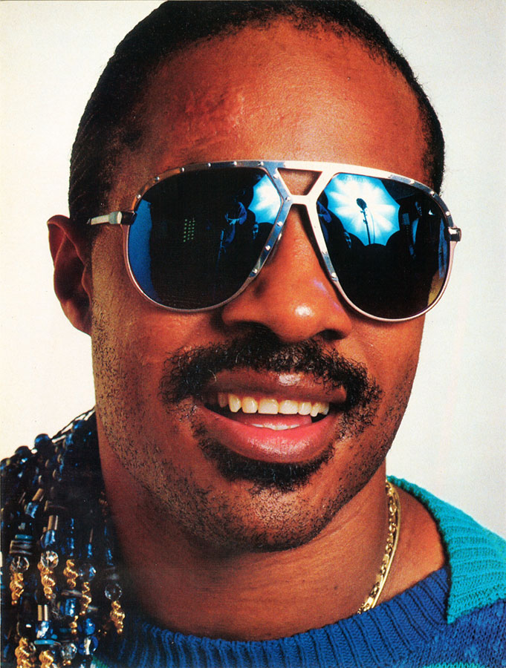
Research Observations
Stevie is talented.
He played most songs by himself, using multiple instruments.
He arranged and produced the entire album.
Inspiration for each song came from something in his personal experiences.

Slide 10
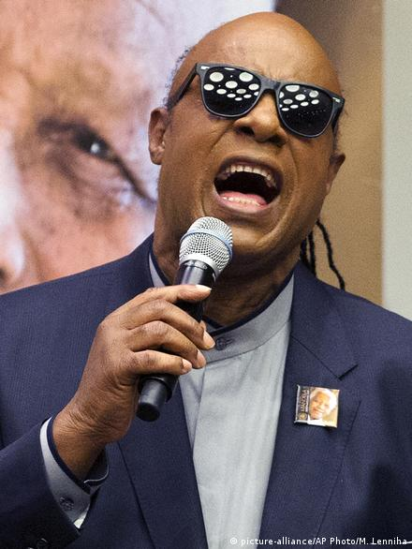
Research Observations continued
Wonder used synthesizers often, and they manipulated the sound of songs.
The variety was impressive. The album features numerous performers and musical instruments.
The rhythms in the songs were inspired by music that Stevie enjoys.

Slide 11
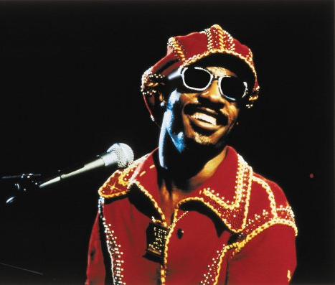
Impact of Research
Students reported being more appreciative of lyrics and their meanings.
They became more aware of messages and stories within each song and enjoyed them more.
They commented that the different and unique instruments came together to create something beautiful.

Slide 12
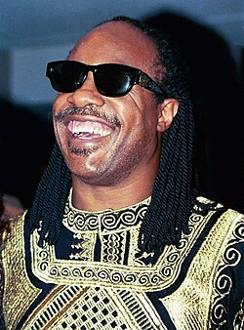
Impact of Research continued
Students appreciated the time and effort put into each song.
Their respect for Stevie Wonder grew after they learned about his history and the stories behind the songs.
        Many noted the repetition in many songs.

Slide 13
Research Question #4
Because most of the students liked the songs better after they conducted research on them, we asked, “Is it important to know the background of a song? Or should the music just speak for itself?”
The consensus was it is important to know the background.

Slide 14
One student’s response
This research changed the way I listened to songs, encouraging me to pay closer attention to the lyrics and themes.
It also highlighted Wonder's ability to transform personal memories and emotions into songs.
-- Niamh Moore

Slide 15
Student Researchers
Matthew Barber
Aubrey Domres
Jacob Frank
Montana Geibel
Elisabeth Hassett
Lyndsey Lilly
Declan McGrath
Niamh Moore

Slide 16
Student and Faculty Comments/Research

Slide 17
‘Love’s in Need of Love Today’
The song opens the album, setting up the record’s serious and reflective tone from the very beginning.
Wonder performs most of the instruments and vocals himself, including keyboards, synthesizers, drums and background vocals.
The song combines a spiritual message with a warning about the condition of society: Love is presented as something people have to actively protect.
The song is one of the tracks that shows Wonder’s spiritual side, and its message connects with several of the album’s larger themes, including love, faith, compassion and responsibility toward other people.
-- Matthew Barber

Slide 18
‘Love’s in Need of Love Today’ continued
This song emphasizes the importance of personal faith and reflection.
Wonder suggests that prayer is available to everyone regardless of circumstances, presenting spirituality as a source of guidance, hope, and inner peace rather than as part of any particular religious tradition.
-- Matthew Barber

Slide 19
‘Love’s in Need of Love Today’ continued
Stevie Wonder wrote the album’s opening song in late 1974 while staying in a New York City hotel, building his lyrics around the idea that love needs to be cared for and protected just like anything else.
After the Sept.11, 2001, attacks, Wonder performed the song with the vocal group Take 6 during the America: A Tribute to Heroes benefit concert. Their performance won a Grammy Award for Best R&B Performance by a Duo or Group with Vocals.
-- Matthew Barber

Slide 20
‘Have a Talk with God’
Stevie Wonder wrote this one to encourage people to turn to God during difficult times instead of feeling alone or overwhelmed.
Although the lyrics reflect his Christian faith, the message can also be understood as finding hope, guidance, and peace during life's challenges.
  -- Matthew Barber

Slide 21
‘Have a Talk with God’ continued
Stevie Wonder co-wrote the song with his brother Calvin Hardaway.
The song uses a relatively short running time of two minutes and 43 seconds to deliver its message directly.
Its synthesizer-driven sound gives the song a different feel from a traditional gospel performance.
The song is part of the spiritual side of Songs in the Key to Life, an album that also addresses family, poverty, race, and social responsibility.
-- Matthew Barber

Slide 22
‘Village Ghetto Land’
Stevie co-wrote this song with Gary Byrd to raise awareness about poverty, inequality, and the hardships faced by people living in poor communities.
The lyrics describe issues such as hunger, crime, homelessness, and the lack of opportunities for many people, encouraging listeners to think about social problems that are often ignored.
-- Matthew Barber

Slide 23
‘Village Ghetto Land’ continued
The song uses a dramatic, almost orchestral sound created with synthesizers to contrast with its disturbing description of poverty and life in neglected communities.
Stevie Wonder co-wrote the song with Gary Byrd and produced and arranged the track. Wonder performed the lead vocals and synthesizer parts on the recording.
The song connects to the album’s wider themes of social responsibility and inequality, showing how Songs in the Key of Life moved beyond personal experiences to address serious problems affecting society.
-- Matthew Barber

Slide 24
‘Sir Duke’
Although the title of the song refers to Duke Ellington, in the lyrics Stevie Wonder also acknowledges other musicians who influenced his career: Count Basie, Glenn Miller, Louis Armstrong and Ella Fitzgerald. The song details how music can bring people together.
In the opening lines, Wonder declares, “Music is a world within itself with a language we all understand, with an equal opportunity for all to sing, dance and clap their hands.”
This is the first of two we took.
-- Anne and Richard Lee

Slide 25
‘I Wish’
The theme is Stevie Wonder’s wish to return to his childhood.
His tale is that he went to a Motown picnic and the atmosphere he experienced inspired him to go right to the studio to write this song.
Originally, the song was more nostalgic and somewhat melancholy. It became more joyful after he put together a band to play it.
-- Niamh Moore

Slide 26
‘I Wish’ continued
"I Wish" gave me more of an appreciation for Wonder's musical ability to transform personal memories into music that feels intimate and universal.
I found it interesting that the atmosphere of a Motown picnic inspired Wonder to immediately go to the studio and write the song and that it was originally intended to be more nostalgic before evolving into the joyful track it became with the addition of the band.
-- Niamh Moore

Slide 27
‘Knocks Me Off My Feet’
Stevie Wonder sings about being loved so overpowerfully by a woman that he’s feeling caught off guard and vulnerable.
He played every instrument on this song, including piano, bass and drums. He added hesitations in the drums to represent how he hesitated to show too much love.
-- Declan McGrath

Slide 28
‘Knocks Me Off My Feet’ continued
Stevie Wonder captured the overwhelming, vulnerable sensation of deep romantic love in "Knocks Me Off My Feet" released during his mid-1970s creative peak.
Part of a broader focus on fundamental human experiences, the track pairs the euphoria of being captivatingly loved with the underlying hesitation and fear of going "all in" too fast.
Knowing that Stevie wrote, arranged and performed the entire soundtrack independently only heightens the appreciation for its emotional depth and genius craft.
-- Declan McGrath

Slide 29
‘Pastime Paradise’
Stevie Wonder encourages his listeners to think about how they live their lives, criticizing those who obsess over the past and encouraging people to live in the present moment.
-- Lyndsey Lilly

Slide 30
‘Pastime Paradise’ continued
"Pastime Paradise" is a song that requires you to listen to the lyrics rather than only feel them.
This song encourages people to take a look at their current lives and focus on building a better future rather than reminiscing on the past.
Through powerful lyrics, Stevie Wonder promotes self-reflection, personal growth, and creating a better world.
-- Lyndsey Lilly

Slide 31
‘Summer Soft’
Stevie Wonder writes about a romantic relationship that didn’t work out, describing the woman with details of the summer and comparing the man to winter.
It is a reflection of his divorce from his first wife, Syreeta Wright.
-- Elisabeth Hassett

Slide 32
‘Summer Soft’ continued
“Summer Soft” also displays Stevie Wonder’s connection with nature after his accident, as he uses seasons to demonstrate the cycles of a relationship.
Another interesting analysis that I found was the musicality of the piece. As the song continues, the key changes multiple times, conveying more emotion as the cycle goes on and giving a sense of desperation.
-- Elisabeth Hassett

Slide 33
‘Ordinary Pain’
The song about a failed romance goes from a sad ballad to a funky beat, and the point of view changes from that of the man to that of the woman.
Shirley Brewer is among the vocalists, delivering a very good performance in ensuring people know the man’s heartbreak was simply what he had coming.
The music paints a picture of the minds and feelings of each character.
-- Aubrey Domres

Slide 34
‘Ordinary Pain’ continued
I think including these two characters made the song stand out and become more interesting.
The background music switching can represent the difference of the state of two people within a story.
-- Aubrey Domres

Slide 35
‘Isn’t She Lovely’
This is the second of two that we, the Lees, took. We told our students that back in 1983, when Anne was expecting our first child, Rich promised he would put “Isn’t She Lovely” on our answering machine if the baby turned out to be a girl. She did.
In 2015, we saw Stevie perform in Buffalo. He proudly brought his daughter to the stage and announced that she had just finished her master’s degree and that her two children call him PopPop.
-- Anne and Richard Lee

Slide 36
‘Joy Inside My Tears’
The song’s lyrics “You made life history” highlight finding hope and happiness during times of struggle.
This song featured many musicians and singers.
I think it was amazing that Stevie wanted to showcase the talents of other Black artists. It adds so much life to his album, no pun intended.
-- Jacob Frank

Slide 37
‘Black Man’
This Stevie Wonder song promotes harmony around the world and serves as a platform to educate people on the overlooked achievements of many people from different races.
“Black Man” was highly acclaimed by music critics and is still used as a call for action in a divided and unfair society.
-- Montana Geibel

Slide 38
‘Black Man’ continued
Stevie made this song not only reflective of his life, as most of the album is, but also made it to reflect the reality of our whole nation.
It was a wake-up call to the unfairness in credits given for the building of our country, especially the foundation and backbone of the USA.
-- Montana Geibel

Slide 39
‘Ngiculela--Es Una Historia--I Am Singing’
Stevie Wonder’s message is that no matter the language, music unifies people and can make the worst days feel better. To this day, the song is celebrated as a multilingual work of art.
Wonder sang all the vocals, which are in Zulu, Spanish and English. Thoko Mdalose Hall helped write the Zulu lyrics, and Raymond Maldonado helped write the Spanish lyrics.
-- Montana Geibel
Notes:
Note: Student researched

Slide 40
‘Ngiculela--Es Una Historia…’ continued
You have to really understand Zulu and Spanish to understand this song and its message of love and peace, but if you do not understand those languages on that level, it sends just a general message in English of love of all people and the love that singing and music can spread.
-- Montana Geibel
Notes:
Note: Student researched

Slide 41
‘As’
After Stevie Wonder was injured in a car accident, he decided he would change how he lived his life.
He moved to Ghana to help others and found a new love for life and humanity.
The lyrics of the song declare that he will love his partner until the impossible comes, learning that even through such a difficult time he could love unconditionally again.
-- Elisabeth Hassett

Slide 42
‘As’ continued
The song is very repetitive and circular, making the listener feel it could continue forever. The song lasts for approximately seven minutes and is one of the longer ones on the album, which contributes to this feeling.
The music also stays joyful throughout, giving the listener an experience that makes them feel the true love that Stevie Wonder wants to convey with this song.
-- Elisabeth Hassett

Slide 43
‘If It’s Magic’
This song feels like the nostalgic memories of childhood and how amazing but finite they are.
Stevie Wonder focuses on the dynamics of what’s good and bad in complex relationships.
To enhance the ideas in this song, Stevie uses similes to compare magic to reality.
-- Jacob Frank

Slide 44
‘Another Star’
"Another Star" is a story of unrequited love that remains even after the relationship ends and accepting that the person you love now loves someone else.
The song combines upbeat music with emotional lyrics, allowing listeners to connect on a deeper level. “Another Star” showcases Wonder's talents as a producer, writer and performer while featuring many other talented artists.
-- Lyndsey Lilly

Slide 45
‘Another Star’ continued
In this upbeat song about unrequited love, Stevie Wonder expresses his feelings for someone who chose another person, noting he accepts the situation though his love remains.
The inspiration for “Another Star” came from Stevie Wonder’s love of Latin-American and Brazilian music, which is reflected in the song’s rhythms and percussion.
-- Lyndsey Lilly

Slide 46
‘Saturn’
Stevie Wonder originally planned a song titled “Saginaw” about his birthplace in Michigan.
Guitarist Michael Sembello misheard what Wonder told him and wrote down “Saturn.” Stevie found the mistake humorous and, after a lot of thought, rewrote the song focused on a distant utopia.
SZA won a Grammy in 2024 for her song by the same title, which she said was inspired by Wonder’s song.
-- Declan McGrath

Slide 47
‘Saturn’ continued
"Saturn" uses the perspective of an extra-terrestrial visitor to critique humanity's self-destruction through war, pollution, greed, and hypocrisy.
By contrasting earth’s flaws — where leaders use "a gun and a Bible" and peace is pursued through conflict — with the clean air and 205-year life expectancies of a utopian Saturn, the track delivers a stark wake-up call.
Changing the song's original setting from Saginaw to Saturn transformed a local reflection into a powerful, cosmic plea for environmental and societal redemption.
-- Declan McGrath

Slide 48
‘Ebony Eyes’
This song was not included in the original album; it was released in a special EP titled “A Something’s Extra” on the same day the album was released.
The muse behind the lyrics is unconfirmed, but there are speculations that it could be either Diana Ross or Florence Ballard.
-- Aubrey Domres

Slide 49
‘Ebony Eyes’ continued
The song maintains a higher energy beat.
The lyrics describe how a man views a woman, mostly with creative metaphors.
The song is quite long; the chorus is repeated a lot.
-- Aubrey Domres

Slide 50
‘All Day Sucker’
This song about one-sided love and being taken advantage of during a relationship came about when the musicians came together and started playing randomly.
The word “sucker” in the title is a metaphor that traces back to 20th century slang comparing gullible people to trapped animals.
-- Niamh Moore

Slide 51
‘All Day Sucker’ continued
Initially, I enjoyed "All Day Sucker" for its memorable melody and background music, but researching its background allowed me to understand the emotions, experiences, and historical context that influenced his creation.
-- Niamh Moore

Slide 52
Easy Goin’ Evening (My Mama’s Call)
Stevie Wonder wrote this as a tribute to family, home and the comfort of returning to loved ones after a long day.
His lyrics reflect warm memories and the importance of staying connected to family despite life's responsibilities.
This song also was on the LP.
-- Matthew Barber

Slide 53
Easy Goin’ Evening … continued
“Easy Goin’ Evening (My Mama’s Call)” was included on the bonus 7-inch record that accompanied the original Songs in the Key to Life album, alongside “Saturn,” “Ebony Eyes,” and “All Day Sucker.”
The song has a much more relaxed and personal feeling than some of the album’s socially conscious tracks, focusing on the comfort and familiarity of home and family.
Its warm subject matter connects with other songs on the album that explore family, love, childhood, and personal memories, showing another side of Stevie Wonder’s songwriting.
The song helps balance the heavier themes on the album by offering a simpler and more intimate reflection on family and the feeling of returning home.
-- Matthew Barber

Slide 54


Other Musicians
on Album

Slide 55
Greg Phillinganes
Keyboardist Greg Phillinganes, who was 18 at the time, later became Michael Jackson’s musical director.
Having played keyboards for Jackson’s Thriller makes Phillinganes the most heard keyboard player of all time given that Thriller, at 70 million copies, is the bestselling record in the world.

Slide 56
Dorothy Ashby
Stevie did the producing and recording himself on “If It’s Magic.”
The only other person on this track is Dorothy Ashby, an American jazz harpist, singer and composer. (Her real name was Dorothy Jeanne Thompson.)
Drummer Raymond Pounds recalls suggesting her because Alice Coltrane, the harpist originally selected, was not listening to what Stevie wanted.

Slide 57
Renee Hardaway
Wonder’s sister Renee Hardaway is the voice playing young Stevie on “I Wish.”
The sibling relationship shared by Wonder and Hardaway adds to the reminiscent feelings of childhood during Christmas time.

Slide 58
Other Performers: West Los Angeles Church
of Christ Choir
Toward the end of “Pastime Paradise,” the West Los Angeles Church of God Choir sings “We Shall Overcome.”
While writing this song, Stevie Wonder was inspired by classical music and street culture.

Slide 59
Closing Reflection
“I love the story that goes into every track Stevie produced. You can really feel the connection to the people who put so much into this album, and that is why it still holds up today.”
-- Jacob Frank

Slide 60
Works Cited
“Black Man,” A Genius Stevie Wonder.
Duke, Ceclia, “The Significance of Another Star by Stevie Wonder: The Ultimate Tribute to Love,” Musician Wages, April 28, 2024.
Light, Alan. “Songs in the Key of Life,” Pitchfork, August 21, 2016.
MacHattie, Callum. “The sound of change: Five albums that defined life in 1976,” Far Out, Aug. 4, 2026.

Slide 61
Works Cited
“Pastime Paradise,” Songfacts.
“Stevie Wonder's 'As' - Chord voicings and analysis,” The Piano Shed, Oct. 4, 2013.
“Stevie Wonder: I Wish,” Classic Motown.
Stevie Wonder - Songs In The Key of Life: Documentary
“Stevie Wonder|Summer Soft,” Modulation of the Day.
Stevie Wonder: The Incredible Story of a Musical Visionary

Slide 62
Thank you

